Slide 1

QuantumShield AI
Explainable Insider Threat Detection Platform for Banking
Detect. Explain. Protect. Future-Proof Banking Security.
Your Team Name : COINCRAFT
Your team bio :Turning ideas into impactful solutions
Date : 16/07/2026

Slide 2
The Challenge
Banks depend on privileged users—including administrators, employees, contractors, and third-party vendors to manage critical systems. While these users are essential for daily operations, they also represent one of the largest cybersecurity risks.
Traditional security tools focus primarily on known attack patterns and static rules. They often generate excessive false alarms, fail to recognize unusual user behavior, and provide little insight into why an alert was triggered. This delays incident response and increases operational risk.
Our Goal
Instead of relying only on static security rules, QuantumShield AI learns how every privileged user normally behaves over time. It continuously compares live activity against this behavioral profile, combines rule-based risk scoring with machine learning anomaly detection, explains every security decision using Explainable AI (XAI), automatically responds to high-risk incidents, and secures audit evidence with quantum-resistant cryptography.
.

Slide 3
Pre-Requisite
To enable effective insider threat detection, QuantumShield AI requires:
Authentication with Multi-Factor Authentication (MFA) and Role-Based Access Control (RBAC)
Access to privileged activity logs such as login records, database operations, administrator commands, and file access events
Historical employee behavior
PostgreSQL database
Docker deployment environment
Python runtime
Modern web browser for dashboard access
The platform works with simulated banking activity during demonstrations and can later integrate with enterprise logging systems.
30 day behavioral data is used to train the AI model for each user.
Isolation forest identifies abnormal behavior by comparing real-time activities with each user's normal behavior pattern.

Slide 4
Tools or resources
Category | Tools & Technologies | Purpose in the Project
Frontend | React, Next.js | Build an interactive dashboard for monitoring insider threats, alerts, and risk scores.
Backend | Python, FastAPI | Process user activities, manage APIs, and connect the AI engine with the dashboard.
Database | PostgreSQL | Store user profiles, activity logs, risk scores, alerts, and audit records securely.
Machine Learning | Scikit-learn | Train and evaluate machine learning models for insider threat detection.
ML Models | Random Forest, XGBoost, CatBoost | Classify user activities as normal or suspicious. CatBoost achieved the best performance and is used as the final prediction model.
Data Processing | Pandas, NumPy | Clean, transform, and prepare activity logs for machine learning.
Feature Engineering | Label Encoding, Feature Engineering | Convert user activity into meaningful numerical features for model training.
Explainable AI | SHAP | Explain why the AI classified a user as risky by showing the features that influenced the prediction.
Model Storage | Joblib / Pickle | Save the trained AI model and load it for real-time predictions.
Visualization | Matplotlib, Seaborn | Generate feature importance charts, ROC curves, confusion matrices, and SHAP visualizations for model analysis.
Authentication & Security | JWT, MFA, RBAC | Secure user authentication and restrict access based on roles.
Deployment | Docker | Containerize the application for easy deployment across cloud or on-premises banking environments.
QuantumShield AI combines Machine Learning, Explainable AI (SHAP), secure authentication, and modern web technologies to deliver real-time, transparent, and scalable insider threat detection for banking environments.
React + Next.js
│
▼
FastAPI Backend
│
▼
Machine Learning
(CatBoost + SHAP)
│
▼
PostgreSQL Database
│
▼
Live Dashboard
Technology Flow

Slide 5
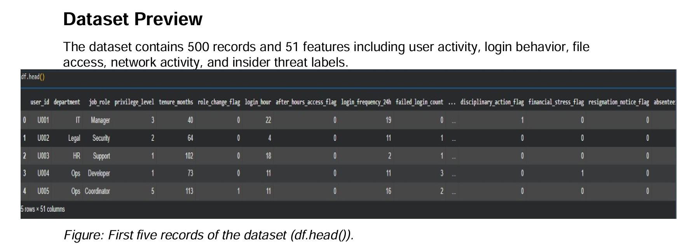
Supporting Functional Documents
System Architecture
QuantumShield AI is supported by technical documents including system architecture, AI workflow, risk scoring logic, user flow diagrams, database design, and prototype screenshots. Together, these documents explain how the platform detects insider threats, provides explainable AI-based decisions, and ensures secure, scalable deployment for modern banking environments.
Employee Activity
│
▼
Authentication
│
▼
Activity Logs
│
▼
Feature Engineering
│
▼
CatBoost Model
│
▼
SHAP Explainability
│
▼
Risk Score
│
▼
Dashboard & Alerts
│
▼
Quantum-Proof Audit Logs
🤖 ML Workflow
Data → Training → Prediction → SHAP
📊 AI Risk Scoring
User activity → Risk Score → Alert
👤 User Flow
Login → Detection → Response

Slide 6
Key Differentiators
Traditional Security Systems
Rule-Based Detection Relies on predefined rules and signatures, making it difficult to detect new or unknown insider threats.
High False Positives Generates many unnecessary alerts, increasing manual investigation and reducing analyst efficiency.
Limited User Understanding Monitors isolated events instead of learning each user's normal behavior over time.
Manual Investigation Security teams must manually analyze alerts, leading to slower incident response.
Limited Explainability Provides alerts without clearly explaining why a user or activity was classified as suspicious.
QuantumShield AI
AI-Powered Threat Detection Uses CatBoost Machine Learning to identify suspicious insider activities with higher accuracy.
Behavioral Learning Learns normal user behavior from historical activity and detects unusual actions in real time.
Explainable AI (SHAP) Explains every AI prediction by highlighting the key factors that contributed to the risk score.
Real-Time Risk Scoring Analyzes user activities instantly and assigns a dynamic risk score for faster decision-making.
Quantum-Safe Security Protects sensitive audit logs and security records using Quantum-Proof Cryptography (QPC) for long-term security.

Slide 7
Adoption Plan
Pilot Branch
│
▼
Multiple Branches
│
▼
Enterprise Banking
│
▼
Multi-Bank Platform
Phase 1 – Pilot Deployment
Deploy QuantumShield AI in a single bank branch or Security Operations Center (SOC).
Monitor privileged users and validate AI-generated risk scores using historical activity data.
Phase 2 – Organization-Wide Rollout
Expand deployment across all bank branches and departments.
Integrate with existing IAM, SIEM, and audit logging systems for centralized monitoring.
Phase 3 – Intelligent Automation
Enable automated responses for high-risk insider activities.
Use Explainable AI (SHAP) to support faster investigations and improve analyst confidence.
Phase 4 – Future Expansion
Scale to multi-bank environments and cloud platforms.
Continuously improve AI models and strengthen security with Quantum-Proof Cryptography (QPC).

Slide 8
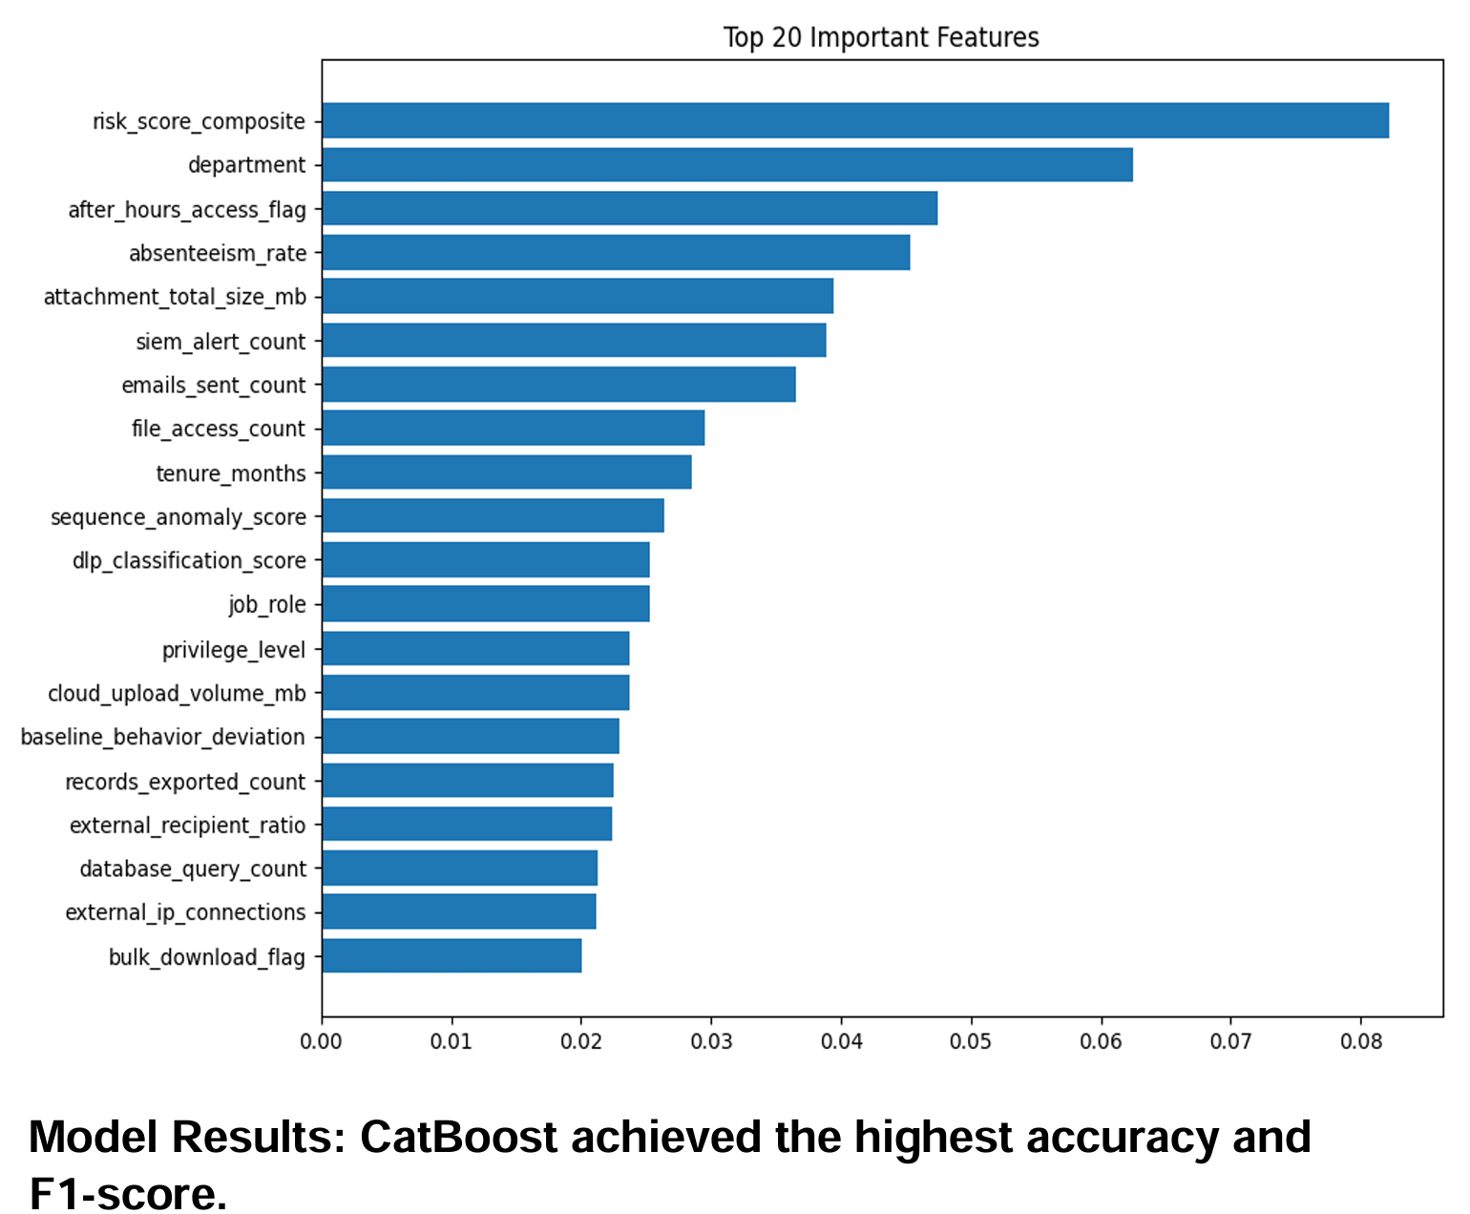
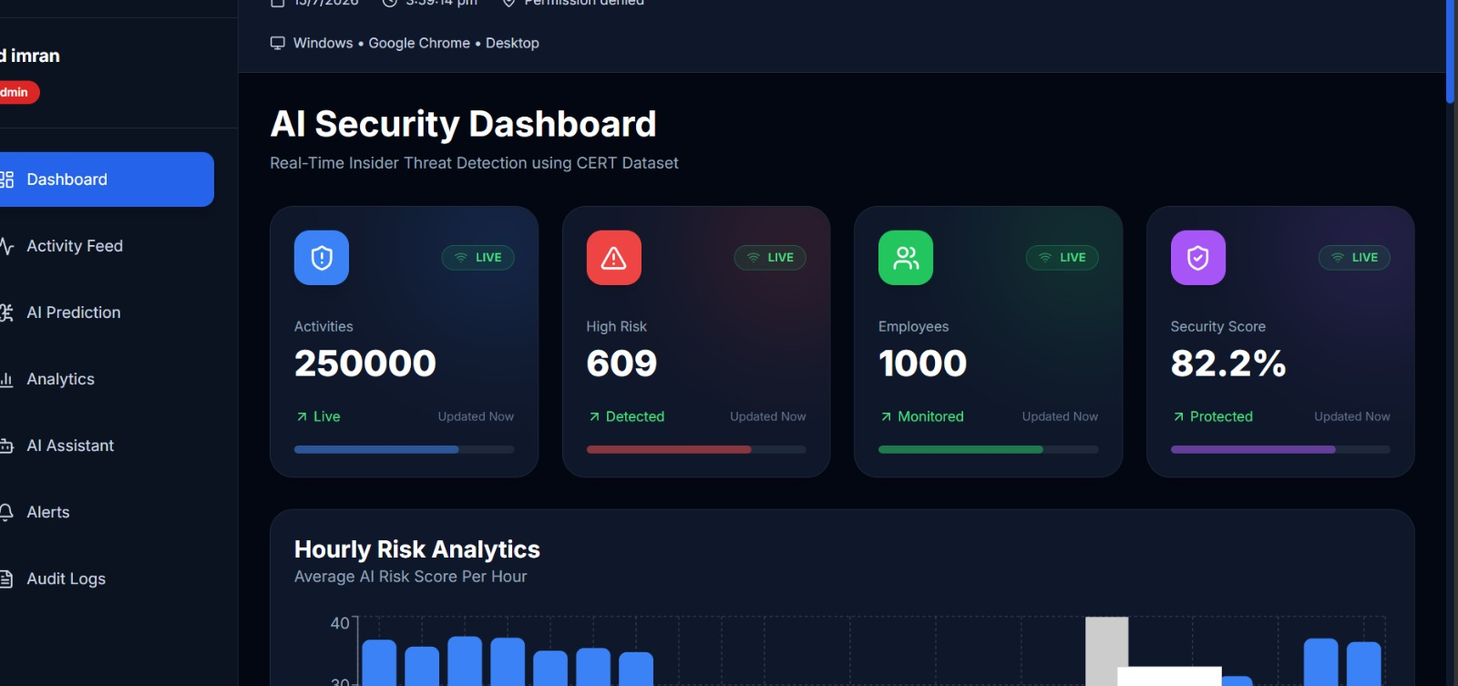
GitHub Repository Link & supporting diagrams, screenshots
QuantumShield AI is supported by a fully functional prototype, complete source code, technical diagrams, and interactive dashboards. These resources demonstrate the implementation, AI workflow, and real-time insider threat detection capabilities of the platform.
💻 GitHub Repository -https://github.com/mdimran2211/FinSpark-hackathon-26

Slide 9
Business Potential and Relevance
Real-World Use Cases:
Protect banks from insider threats and privileged account misuse
Secure sensitive customer and financial data
Help security teams detect and respond to threats in real time
Support compliance with banking security standards
Future Expansion:
Connect with SIEM, IAM, and cloud security platforms
Support multiple banks through a single platform
Add advanced AI models for smarter threat detection
Expand to healthcare, insurance, and government sectors
Long-Term Value:
Reduces financial losses caused by insider attacks
Builds customer trust with stronger security
Future-ready with Quantum-Proof Cryptography (QPC)
Scales easily as organizations and users grow
Today
│
▼
🏦 Banking Security
│
▼
🏢 Multi-Branch Banks
│
▼
🌐 Multi-Bank Platform
│
▼
🏥 Healthcare
│
▼
🏛 Government
│
▼
🌍 Global Enterprise Security

Slide 10
Uniqueness of Approach and Solution
Unlike traditional security systems that rely on fixed rules, QuantumShield AI continuously learns normal user behavior and identifies unusual activities using machine learning. It explains every alert with Explainable AI (SHAP), helping security teams understand why a user is flagged as risky. As user behavior changes over time, the platform adapts to new threats, making insider threat detection more accurate, transparent, and reliable.
Key Innovations
Behavioral AI tailored to individual users.
Explainable AI for transparent decision-making.
Hybrid risk scoring using machine learning and expert rules.
Automated threat containment.
Live attack simulation environment.
Post-Quantum Cryptography for tamper-resistant audit logs.

Slide 11
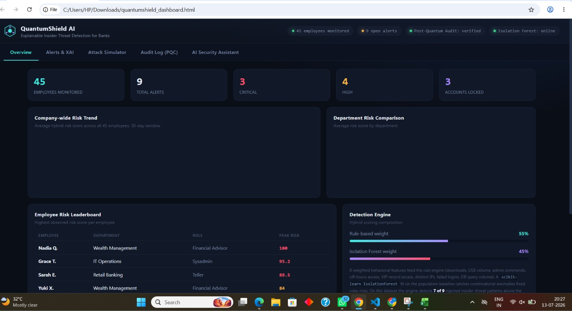
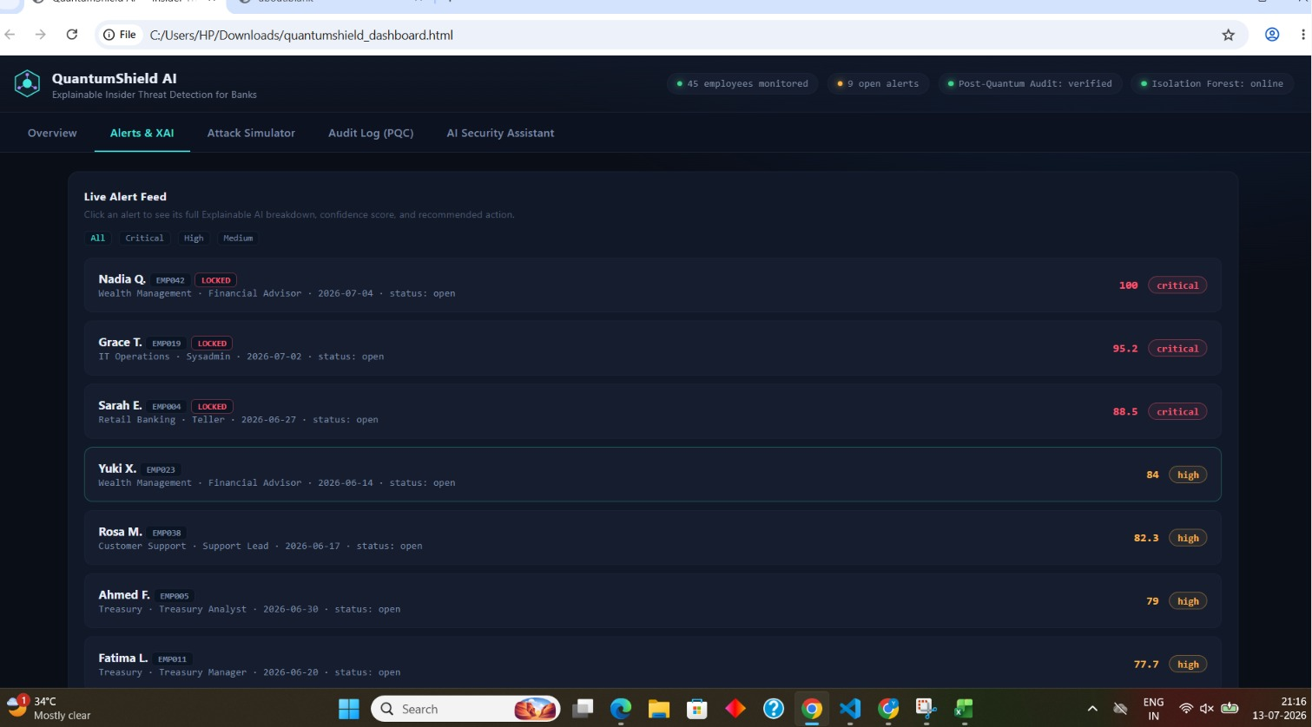
User Experience
QuantumShield AI is designed with a simple and intuitive interface that enables security teams to monitor privileged users, identify insider threats, and take immediate action. The dashboard provides real-time alerts, AI-powered explanations, and risk scores, allowing analysts to make informed decisions quickly without complex manual investigation.
🔐 Login
│
▼
📊 Open Security Dashboard
│
▼
👥 Monitor Users & Live Activities
│
▼
🤖 AI Detects Suspicious Behaviour
│
▼
📈 View Risk Score & SHAP Explanation
│
▼
🚨 Receive Real-Time Alert
│
▼
🛡 Take Action
(Lock Account / Investigate / Resolve)
Live alert Dashboard

Slide 12
Scalability
QuantumShield AI is built using a modular architecture that supports future growth.
The platform is capable of:
Single Branch
│
▼
Multi-Branch Banking
│
▼
Enterprise Banking Network
│
▼
Hybrid / Cloud Infrastructure
│
▼
QuantumShield AI Platform
(AI + XAI + QPC + Automation)
Monitoring thousands of privileged users
Processing more than 10,000 security events per day
Supporting hundreds of concurrent users
Deploying across cloud, hybrid, or on-premises environments
Integrating with enterprise security platforms

Slide 13
Ease of Deployment and Maintenance
IMPLEMENT
┌─────────────────────┐
│ • Easy Deployment │
│ • Docker Support │
│ • API Integration │
└─────────────────────┘
│
▼
OPERATE
┌─────────────────────┐
│ • Real-Time AI │
│ • Live Dashboard │
│ • Instant Alerts │
└─────────────────────┘
│
▼
MAINTAIN
┌─────────────────────┐
│ • Modular Services │
│ • Secure Audit Logs │
│ • Easy Updates │
└─────────────────────┘
│
▼
IMPROVE
┌─────────────────────┐
│ • Model Retraining │
│ • New AI Features │
│ • Future Expansion │
└─────────────────────┘
Easy to Implement
Modular architecture enables quick deployment without changing existing banking systems.
Integrates easily with authentication, audit logs, and security monitoring platforms.
Docker-based deployment simplifies installation across cloud or on-premises environments.
Easy to Operate
Real-time dashboard provides continuous monitoring of privileged user activities.
AI automatically detects suspicious behavior and generates instant risk alerts.
Explainable AI (SHAP) helps security teams understand every prediction quickly.
Easy to Maintain
Microservices architecture allows independent updates to the frontend, backend, AI model, and database.
New user activity logs continuously improve monitoring without disrupting system operations.
Secure audit logs help with compliance and incident investigations.
Easy to Improve
AI models can be retrained with new banking data to improve detection accuracy.
Supports integration with SIEM, IAM, cloud security platforms, and future AI models.
Future-ready with Quantum-Proof Cryptography (QPC) to protect sensitive audit records.

Slide 14
Security Considerations
Security is embedded into every layer of QuantumShield AI.
Security Features:
Multi-Factor Authentication (MFA).
Role-Based Access Control (RBAC).
JWT Authentication.
AI-powered anomaly detection.
Explainable AI decision support.
Automated response engine.
Tamper-resistant audit logs.
Quantum-safe cryptography using Kyber and Dilithium.
These controls enhance resilience against insider threats while supporting compliance with modern banking security requirements.

Slide 15
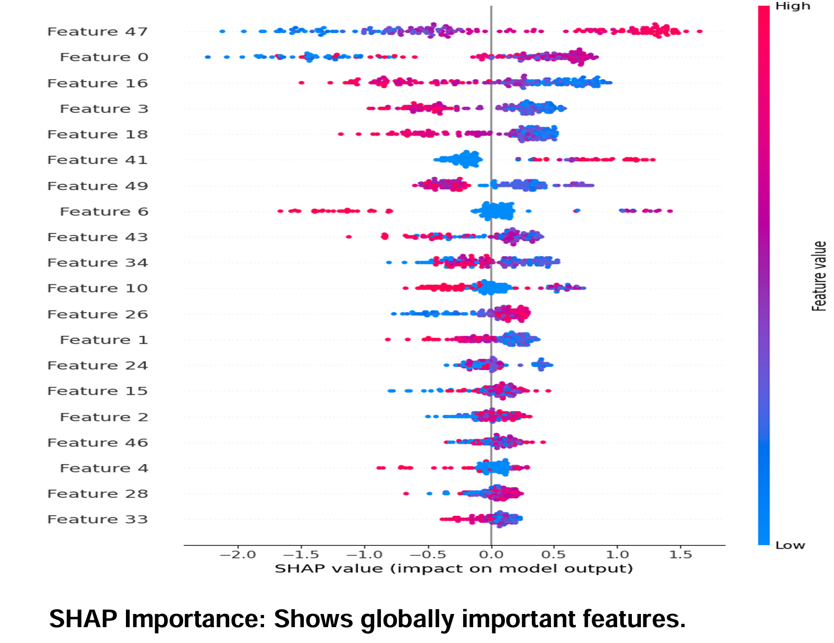
Architecture diagram & Images
👤 Users
(Admin • Employee • Analyst)
│
▼
🔐 Authentication Layer
JWT • RBAC • MFA
│
▼
📥 Activity Collection
Login • File Access • Database • Email
USB Activity • Privileged Commands
│
▼
⚙️ Feature Engineering Layer
Data Cleaning • Encoding • Feature Extraction
│
▼
🤖 Machine Learning Engine
Random Forest • XGBoost • CatBoost
(Best Model: CatBoost)
│
▼
💡 Explainable AI (SHAP)
Explains why a user is marked as risky
│
▼
📊 AI Risk Scoring Engine
Low • Medium • High • Critical
│
┌─────────┴─────────┐
▼ ▼
🚨 Alert Management 🖥 Dashboard
Notifications • Lock User Live Monitoring
│ │
└─────────┬─────────┘
▼
🔒 Quantum-Proof Audit Logs
Secure Storage & Compliance
QuantumShield AI integrates user authentication, activity monitoring, machine learning, Explainable AI, and a real-time dashboard into a single security platform. User activities are collected from banking systems, analyzed using the CatBoost machine learning model, explained with SHAP, and converted into dynamic risk scores. High-risk activities trigger instant alerts, enabling security teams to respond quickly while maintaining secure audit records with Quantum-Proof Cryptography.

Slide 16
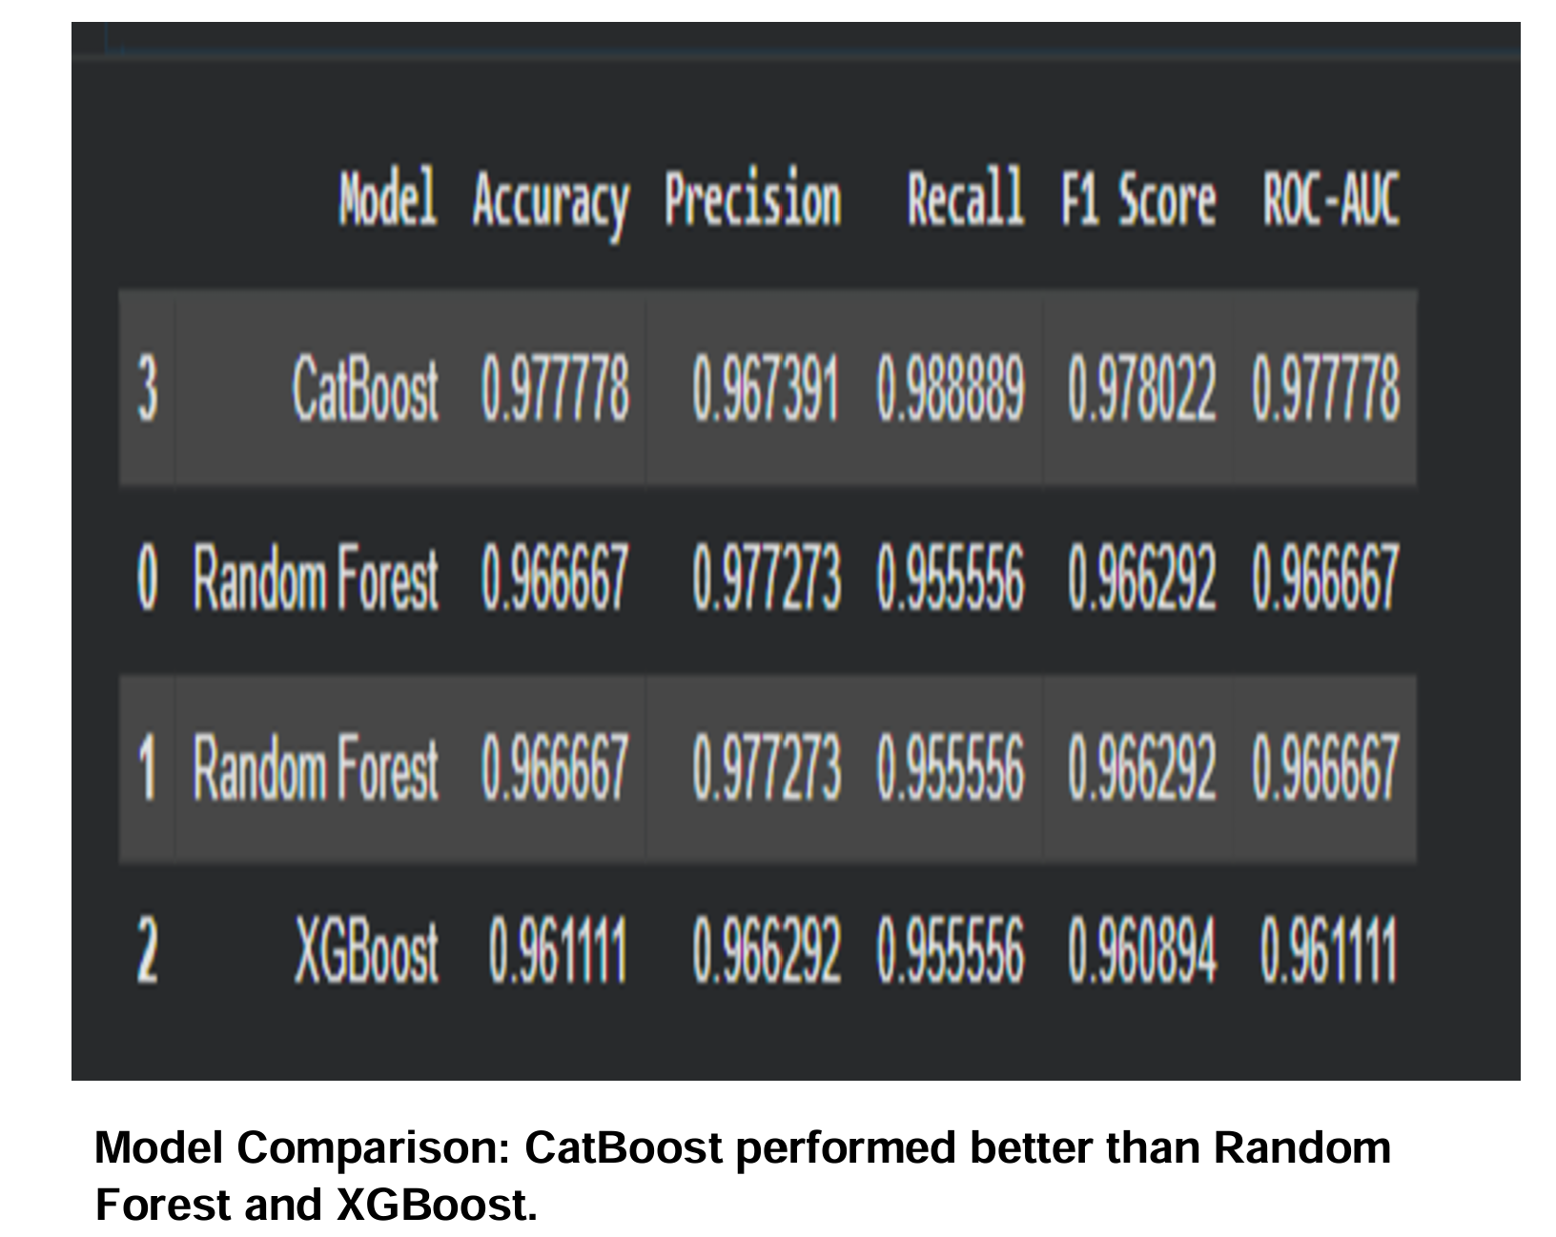

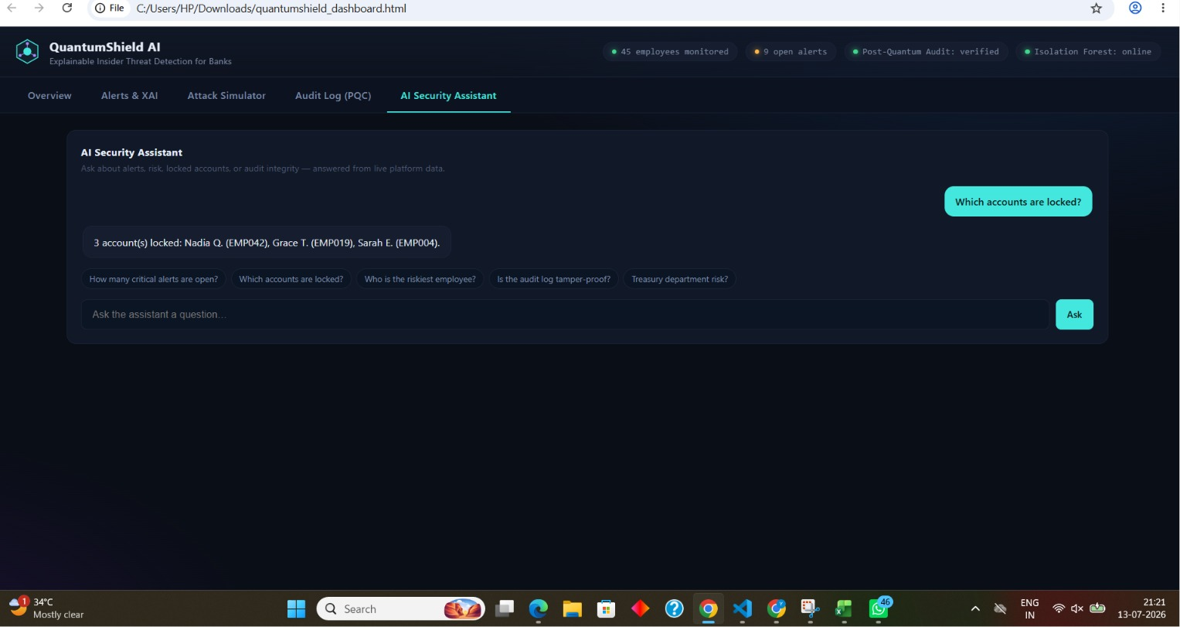
Solution Screenshots & video & Github Link
Our prototype demonstrates the complete workflow of insider threat detection, from user monitoring to risk analysis and alert generation. All supporting resources, including GitHub, demo video, and project documentation, are provided to ensure transparency and easy evaluation.
📂 GitHub Repository QR
▶️ Project Demo Video
https://drive.google.com/file/d/1fZtUrf5n8GURmuO8a6Vu5OF_6xLEn6H_/view?usp=drivesdk

Slide 17
Thank You
We appreciate your time and attention. Feel free to ask any questions or share your valuable feedback.
👥 Team Members
Vaishnavi Jha – Front-end Developer
Md Asif – ML model trend
Md Imran – Backend Developer
Shyamji Dwivedi – Data Collection& documentation
📧 Contact
Email: vaishnavijha2627@gmail.com
GitHub:https://github.com/mdimran2211/FinSpark-hackathon-26

